Slide 1
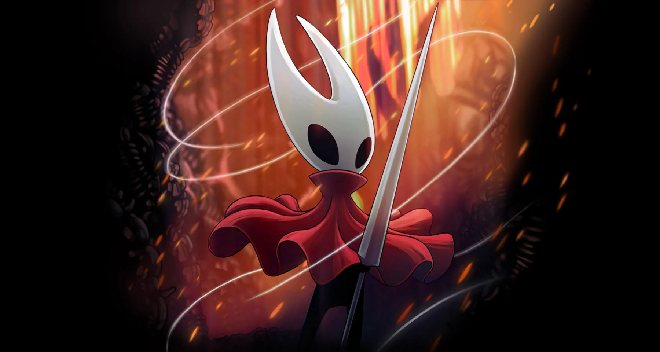
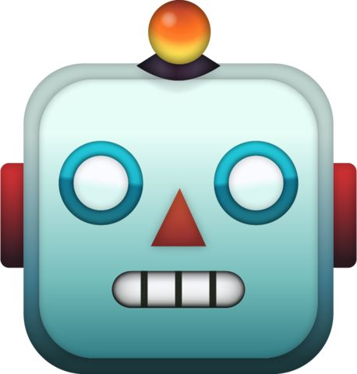
RL for Hollow Knight: Silksong
Puyuan Alvin Ye

Slide 2

Problem Context
Lace: Boss
Hornet: Bot
Notes:
Problem is very simple: jump into the fight, try to make hornet take down lace. If we can’t take her down, try to deal as much damage as possible.

Slide 3
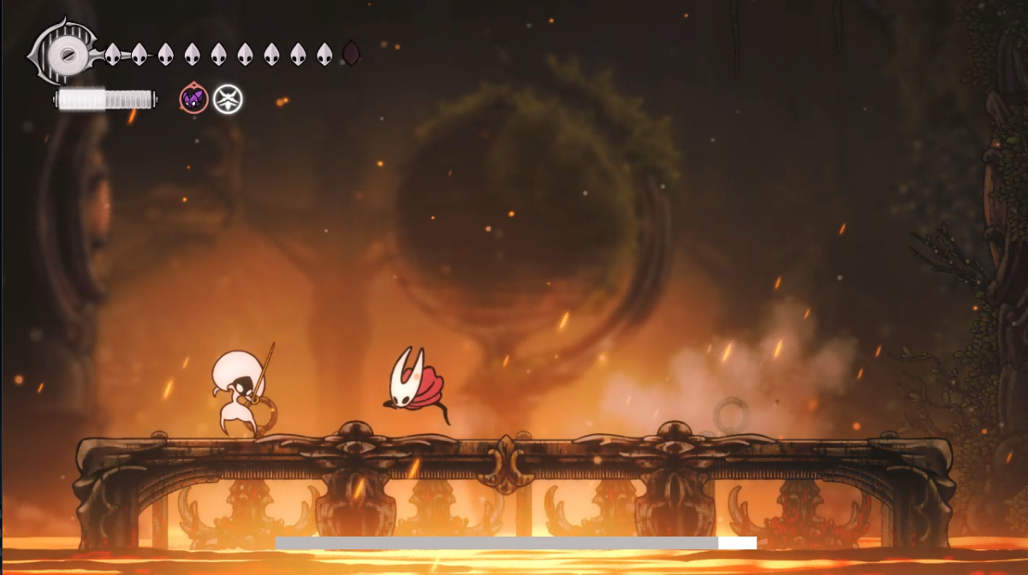
Environment
hornet hp
spell
hornet silk
tool
boss hp (mod)
Notes:
Environment.
This is a screenshot of the game.
At the top left we see many things. They are hornet hp, represented by crests. Number of white crests = number of hp.
Next we see hornet silk bar. There are 18 segments, so 18 units of silk. Hornet gains silk through hitting normal attacks. Healing and casting spell costs silk.
Next we see tool. Another skill like thing hornet can use. Here we are using cogfly with poison. It is like a drone that deals dot.

Slide 4

Environment
Uses Python MSS library to capture the game window at ~6 FPS
Samples specific pixel locations to detect Hornet’s HP, Silk meter, and Boss HP bar
Uses pydirectinput to send keyboard commands
Monitors screen brightness and boss HP bar for win/loss detection.

Slide 5
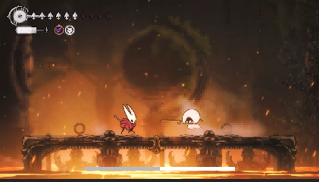
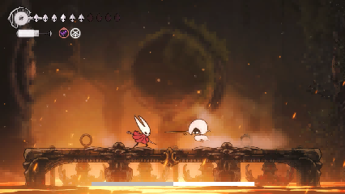
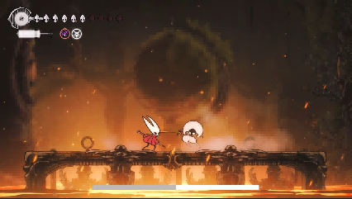
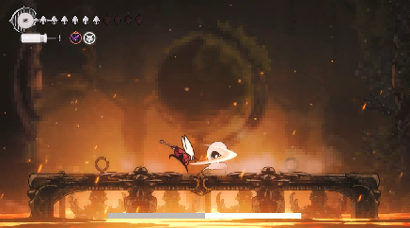
Observation Space
Grayscale: color not needed, smaller and faster to process
Frame stacking: a single frame does not show motion. By staking 4 frames, agent can perceive:
Which direction is the boss moving
Whether Hornet is jumping or falling
Attack animations in progress
I see 192*192 grayscale image with 4 consecutive frames stacked to get motion and velocity information, rescaled to [-1, 1] for neural network input.

Slide 6
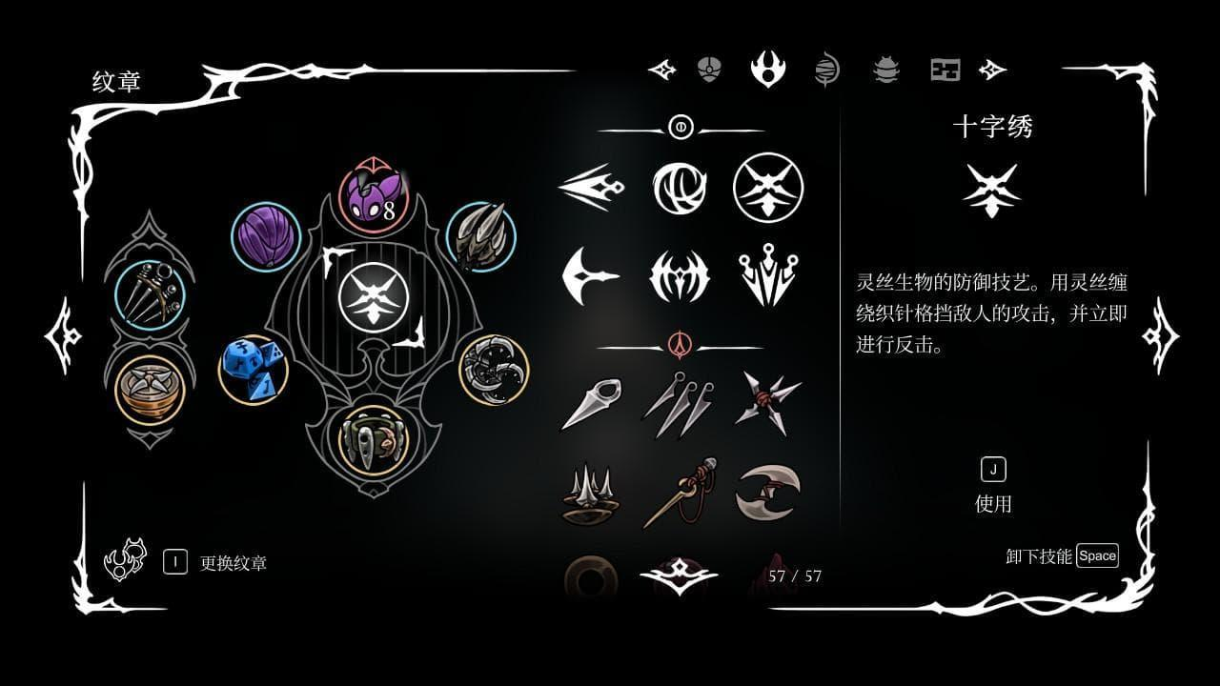
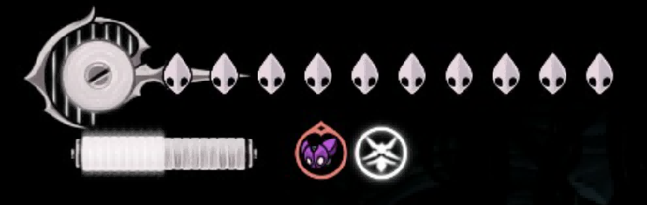
Action Space
Move | None, Left, Right | A, D
Attack | None, Attack, Spell, Tool | K, J, W+J
Displacement | None, Short Jump, Long Jump, Dash | Space, Space, L
Heal | None, Heal | Shift
Notes:
We use wanderer’s crest, so high attack speed but short range.
We equipped these crests. Specifically, for spell we use the parry, for tool we use cogfly. We also have the faster heal and longer attack range. The dice has a 2% chance to dodge any incoming damage, introducing some fun.
Total of 3*4*4*2=96 possible actions.

Slide 7
Neural Network
Architecture: CNN + Dueling DQN
Feature Extractor (CNN):
5 convolutional layers
4 → 32 → 48 → 96 → 160 → 320 channels
Output: 11520-dim feature vector
Decision Head (Dueling DQN):
Separates Value V(s) from Advantage A(s, a)
Q(s, a) = V(s) + A(s, a) - mean(A)
Uses Noisy Networks for exploration
?
Notes:
Hornet’s brain.
Our network has two main parts: a feature extractor and a decision head.
The feature extractor is a Convolutional Neural Network, or CNN. This is the same type of architecture used in image recognition and it makes sense here because our agent is literally looking at screenshots. The CNN has 5 convolutional layers. It takes in our 4 stacked grayscale frames that's the 4 channels going in and progressively extracts more abstract features through 32, 48, 96, 160, and finally 320 channels. By the end, we've compressed a 192-by-192 image down to an 11,520-dimensional feature vector that captures the important visual information: where is the boss, where is my character, what attacks are happening.
The decision head is where we use something called Dueling DQN. This is an improvement over regular DQN. Instead of directly predicting 'how good is this action,' we split it into two questions:
First, Value (V of s) which asks: 'How good is this state overall, regardless of what action I take?'
Second, Advantage (A of s, a) which asks: 'How much better is this specific action compared to the average?'
Then we combine them with this formula Q(s, a) = V(s) + A(s, a) - mean(A). The reason this helps is that sometimes, the state itself determines most of the outcome, like if you're about to die, no action can save you. Dueling DQN learns this distinction faster.
Finally, we use Noisy Networks in the decision head. Instead of using epsilon-greedy exploration where the agent randomly picks actions some percentage of the time, we add learnable noise directly into the network weights. This gives us smarter exploration, the agent learns when and where to explore, rather than exploring randomly.

Slide 8
DQN Improvements Used
Double DQN | Reduces Q-value overestimation
Dueling DQN | Better value estimation
Noisy Networks | Built-in exploration
10-step Returns | Faster credit assignment
DrQ (Data Augmentation) | Better generalization
Mixed Precision (FP16) | 2x faster training
Notes:
Now, our implementation isn't just vanilla DQN; we're using several improvements from the research literature. Let me quickly walk through each one.
Double DQN addresses a known problem where standard DQN tends to overestimate how good actions are. It does this by using two networks: one to select the best action, and a separate target network to evaluate it. This simple change significantly improves stability.
Dueling DQN, which I just explained, separates value from advantage. This helps the network learn faster, especially in states where the specific action doesn't matter much.
Noisy Networks replace epsilon-greedy exploration. Instead of randomly taking actions 10% of the time, we add noise to the network weights themselves. The network learns to control its own exploration, which is more efficient.
10-step Returns is about how we calculate our learning targets. Instead of looking just one step ahead to see what reward we got, we look 10 steps ahead. This helps the agent connect actions to their consequences faster — if I attack now, and the boss takes damage 5 frames later, 10-step returns help the agent learn that connection.
DrQ, or Data-regularized Q, applies random image augmentations — like small crops and scaling — during training. This is similar to data augmentation in supervised learning. It helps the agent generalize better and not overfit to specific pixel patterns.
And finally, Mixed Precision training uses 16-bit floating point numbers instead of 32-bit where possible. This roughly doubles our training speed with minimal impact on accuracy, which is important when we're running hundreds of episodes.
Together, these improvements take us from a basic DQN that might struggle, to a much more capable and efficient learner."

Slide 9
Training
Phase 2: DQN Training
550 training episodes
Learn every 4 environment steps
Update target network every 8000 learning steps
Save best models by reward and boss hp dealt
Phase 1: Random Exploration
75 episodes of random actions
Saves all transitions to replay buffer
Purpose: collect diverse experience
Notes:
Phase 1:
random. Fill up replay buffer; fill up the memory bank that stores every transition.
Saved to disk, so I can reuse that later.
Phase 2:
Real training.
Pick what the NN thinks is good.
Every 4 environment steps, we pause and learn.
Every 8,000 learning steps, we update what's called the target network. Remember Double DQN uses two networks? The target network is a frozen copy of our main network. We periodically sync them up. This provides stability — if we updated the target every step, the learning signal would be too noisy.
Finally, every 10 episodes we run an evaluation. We let the agent play one episode with no exploration noise, purely exploiting what it's learned. If this evaluation beats our previous best — either by total reward or by dealing the most damage to the boss — we save that model.

Slide 10
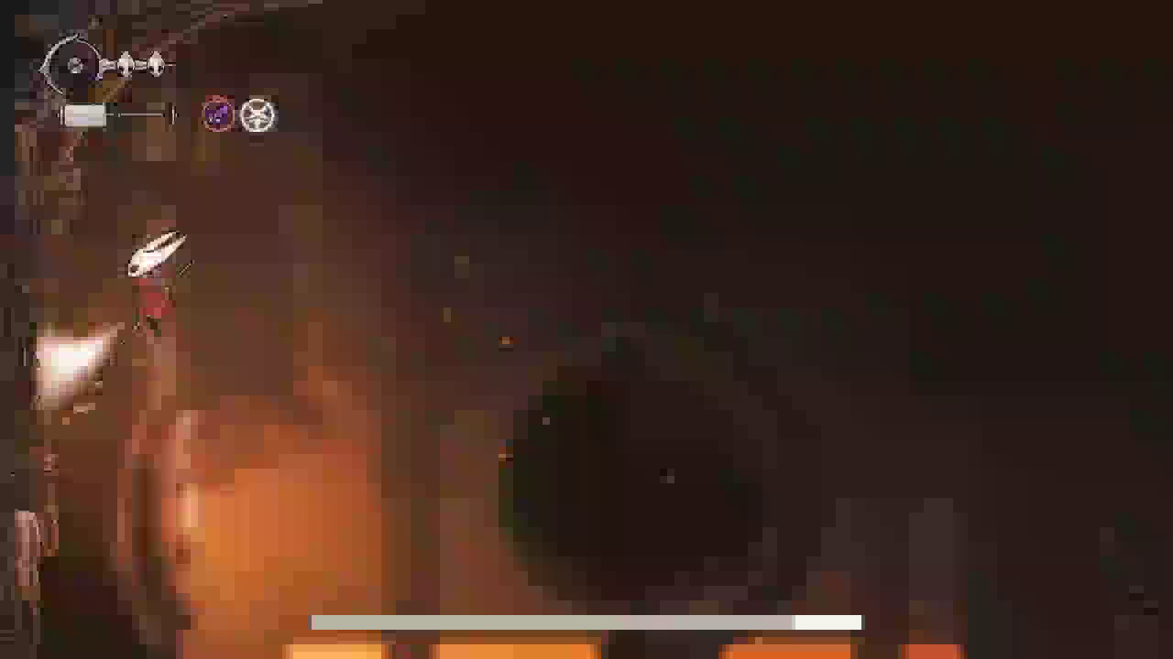


Reward Engineering
Dying does not hurt that much
Taking damage has big penalty
Idle penalty was almost nothing
Staying in corner
Hiding = safe = optimal!
Notes:
hiding = safe = optimal.
Made defeat penalty 40× bigger (-0.2 → -8 or worse)
Added real inactivity penalties (-0.3 every 5s of no damage)
Made victory highly rewarding (+18 to +29) (but we never reached that).

Slide 11
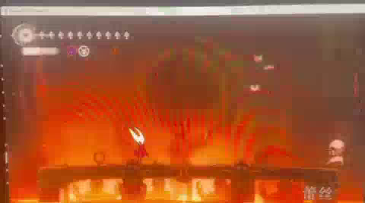

Reward Engineering
Made defeat penalty bigger
Added real inactivity penalties
Dealing damage big reward
Victory highly rewarding
Now uses all cogfly rightaway
Using cogfly no cost, why not!

Slide 12
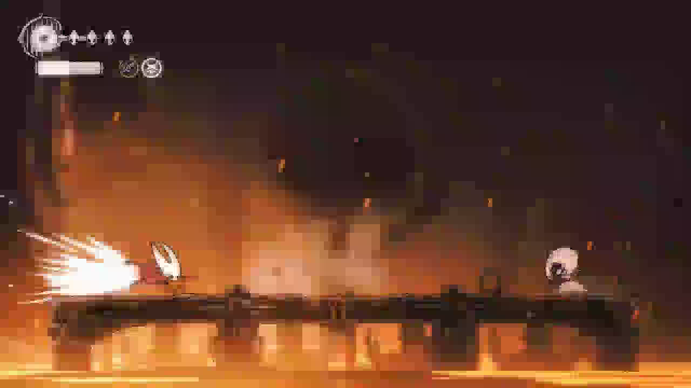

Reward Engineering
Add cogfly cooldown
Award for attack damage dealt
More penalty on defeat
Extra penalty on boss hp
Does not heal up!
Why heal?
Notes:
hiding = safe = optimal.
Made defeat penalty 40× bigger (-0.2 → -8 or worse)
Added real inactivity penalties (-0.3 every 5s of no damage)
Made victory highly rewarding (+18 to +29) (but we never reached that).

Slide 13

Reward Engineering
Extra reward for boss taking damange
Big reward for successful heals
Small punishment for failed heals (interrupted or not enough silk)
Notes:
Space out tool usage, more attack, as attack has higher reward.
Attack = more silk = more heals = more rewards.

Slide 14
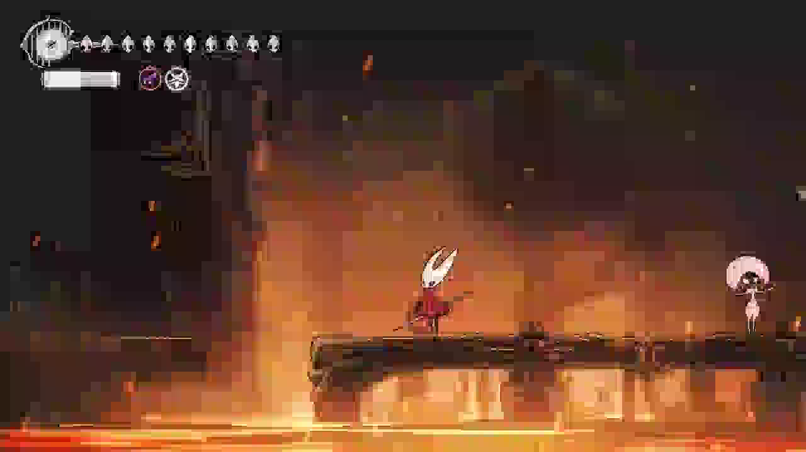

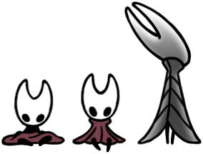
Result & Conclusion
Out of 10 episodes:
4/10 success rate
Average 20.8% boss hp
Thank you!

